Slide 1

CHICAGO CRIME ANALYSIS
Ashton r. wolf
Notes:
Good afternoon class, my name is Ashton representing the Data Warfare Team out of Joint Base Lewis McChord, Washington.
I will be presenting my analysis on the Chicago Public Crime

Slide 2

Chicago crime analysis
As of 2023, the city of Chicago has one of the highest number of violent crimes per capita
This presentation will focus on recorded crimes from the years 2001 to 2022
The Chicago Crime Database is a product of collaborative efforts between the Chicago Police Department (CPD) and other relevant agencies
Notes:
According to the Chicago Sun Times, through analyzing crime statistics, Chicago had its deadliest year in 2021 since in nearly 30 years. There is no singular answer as to why Chicago is subject to a substantially higher amount of crime compared to other major cities. We frequently hear on the news, internet, and social media about prevalent criminal activity in Chicago that includes violent crimes, gun violence, homicides, drug addiction and more. Additionally, while some criminal offenders are put in jail, a 2018 report showed that 43% of those released from prison in Illinois will be convicted of another crime and return to prison.
To gain a better understanding of the situation, I analyzed a publicly available crime dataset from the City of Chicago. My objective was to determine any correlations to the criminal activity.

Slide 3


Exploratory Data Analysis
36 Crime Types
78 Community Areas
50 Wards
24 Districts
227 Locations
548 Crime Descriptions
63085 Blocks
What is in the dataset?
The dataset records more than 7,846,809 criminal incidents.
Categories of data
Notes:
The City of Chicago maintains a very detailed dataset recording incidents of crime that occurred in the city.
At the time of my download of the dataset there were 7.8 million incidents
To the right of my slide are the main features that were used for my data analysis. The numbers represent a count of unique values of those features.
Extra:
This data is extracted from the Chicago Police Department’s CLEAR (Citizen Law Enforcement Analysis and Reporting) system.

Slide 4
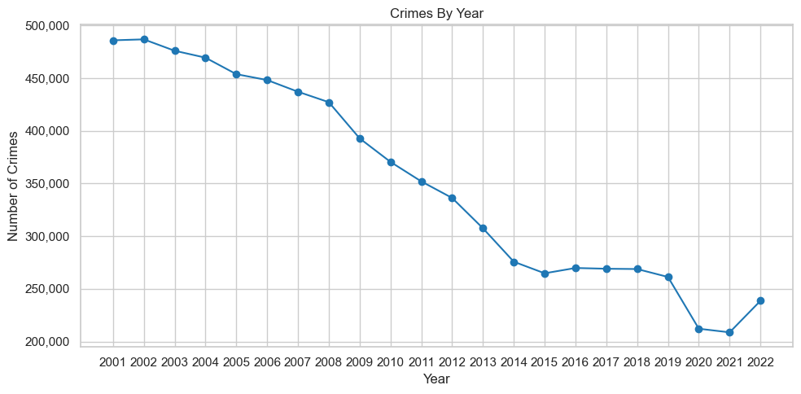
Total Crimes Committed
Notes:
An initial analysis revealed that, contrary of popular opinion, crimes per year, at least those being recorded, has reduced by more than half since 2001.
I want to highlight three significant observations.
1) From 2001 to 2015 there was a gradual decrease of approximant 475,000 crimes per year to 260,000 by the year 2015.
2) From 2015 to 2019, crime rate remained constant
3) From 2020 and 2021 there was another significant drop.
A possible explanation for this was the Covid-19 lockdowns and changing in policing and recording crimes during that time period so it does not necessarily mean that
Crimes were not being committed, only that they were possibly not being recorded.

Slide 5
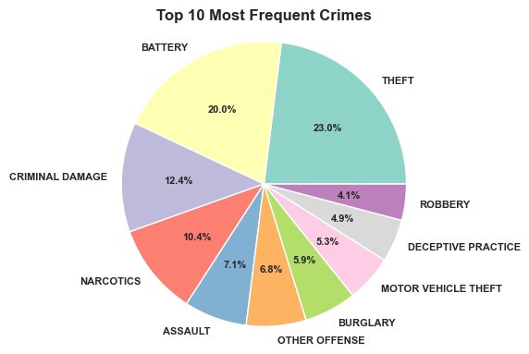
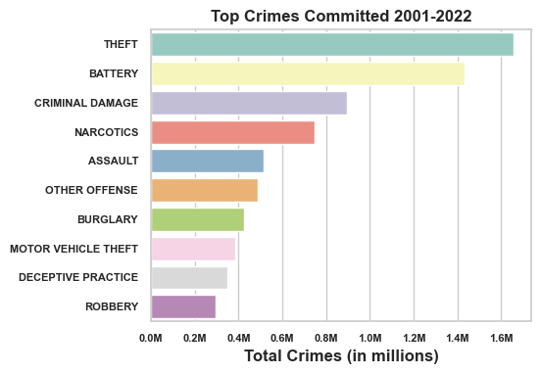
Top Crimes Committed
Notes:
The pie chart on the left represents crimes that occur the most frequently while the horizontal bar chart on the right illustrates the total occurrences for the time period.
An analysis of all 36 crime categories revealed the top the 10 crimes represented in the above pie chart represent 91.57% of all total crimes.

Slide 6
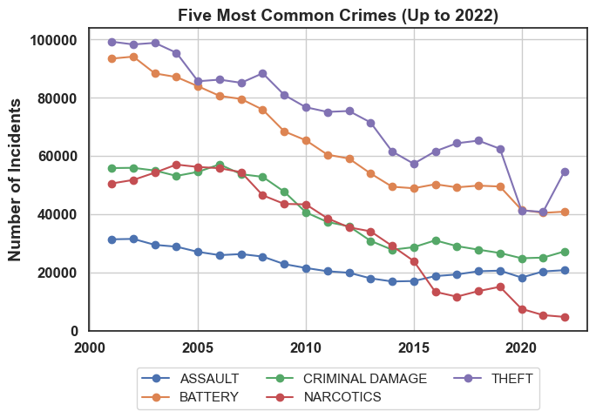
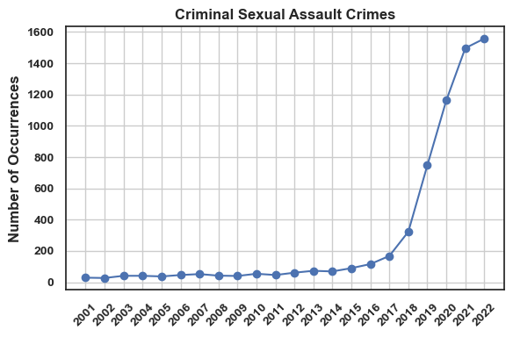
MOST COMMON CRIMES
Notes:
To explore further and with more specificity, I calculated the top 5 most common crimes that were recorded. They too, showed a gradual decrease in with theft, battery and narcotics showing the strongest decline.
Criminal sexual assault crimes, however, were discovered to be an extreme outlier to my EDA, where there was an increase of 2,454% from 2012 to 2022. I created a separate chart as to not drastically skew the first chart.

Slide 7
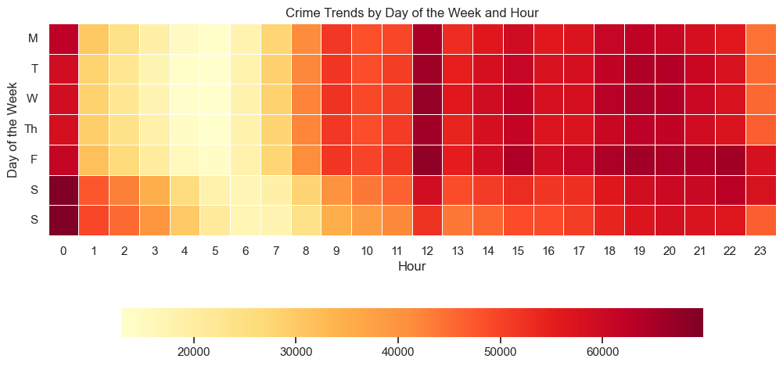
Notes:
Next, I will present identified crime trends:
This heatmap shows the relationship between the day of the week and time of day where a crime is most likely to occur. There are several important takeaways from this data.
1) We can see that crimes are least likely to be committed during the weekday between the hours of 0100 and 0700 and slightly more likely during the same time period on the weekends.
2) The days of the week show that crime is more likely to occur on Friday evenings from 1800 to 2200 with Tuesday and Wednesday not far behind.
3) Noon and Midnight seem to have the strongest probability for a crime to occur daily

Slide 8



HYPOTHESIS TEST
nULL
alternate
The probability of getting arrested has no relationship with the location of the crime.
Arrest probability depends on the type of crime and location it is committed
Notes:
During my analysis I constructed a hypothesis test.
My Null Hypothesis states that there is no relationship between any of the independent variables and the occurrences of arrest for all crimes and reported incident, while my Alternate Hypothesis proposes there is a strong relationship.
As I performed my Exploratory Data Analysis, I implemented logistic regression modeling to confirm or reject my Null hypothesis.

Slide 9
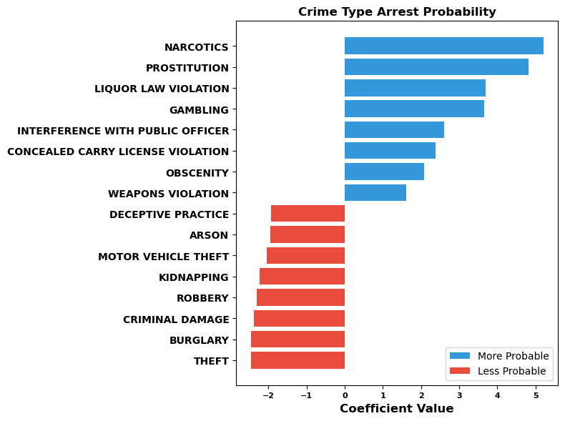
Logistic regression results crimes
POSITIVE coefficients indicate that a higher probability of that crime will result in arrest.
NEGATIVE coefficients indicate that a lower probability of arrest.
Notes:
Using my results, I isolated the top 8 strongest positive and negative deviations from my Null Hypothesis and plotted them on the bar graph on the right of the slide.
The blue bars extending to the right represent crime where arrest is MORE LIKELY while The red bars represent the opposite, arrest is LESS LIKELY. The chart makes it clear that crimes involving narcotics or prostitution have the highest probable arrest rate while theft and burglary are shown to have the lowest probability.

Slide 10
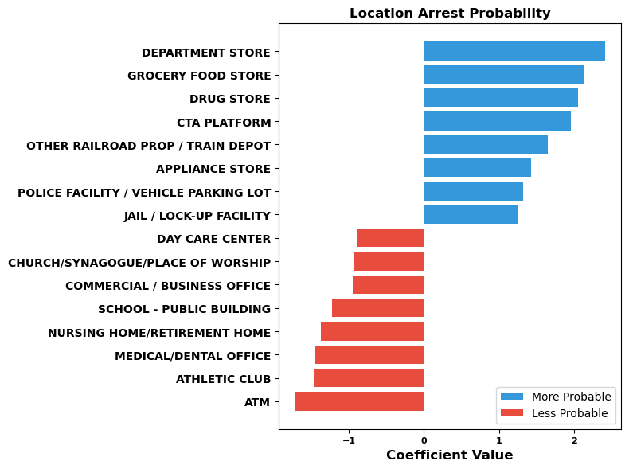
Logistic regression results location
POSITIVE coefficients indicate that a higher probability of that crime will result in arrest.
NEGATIVE coefficients indicate that a lower probability of arrest.
Notes:
In this companion slide, the locations of where crime occurs is the focus. The graph clearly illustrates that crime conducted at commercial businesses such as department, grocery and drug stores have the highest probability for arrest in contrast to ATMs and athletic clubs.

Slide 11
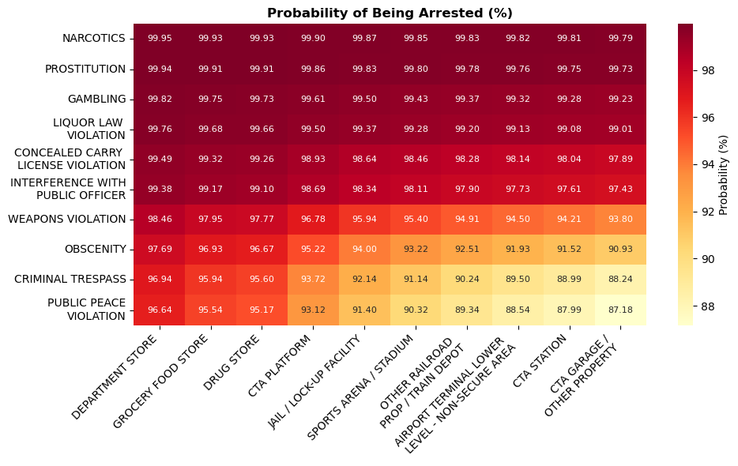
Probability heatmap by crime and location
Notes:
For added data granularity, I cross-referenced the probability of the top crimes and locations to create an intersectional heatmap. This visual representation shows the combinations of crime and location with the probability of arrest. Each cell represents the probability, expressed as a percentage, of an arrest occurring when a specific crime is associated with a particular location.
The bar charts viewed in the previous slides clearly illustrate there is a relationship between arrest rates and the remaining features, which in this example, are isolated to crime type and location.
As seen in the previous two slides, the top crime was narcotics while the top location was department store. We can see in this combination in the heatmap as the intersection indicates, that department stores are central to, and the primary location of the top crimes identified in this analysis.
To conclude, this graph shows a clear and decisive relationship between crime types, the locations where they are committed, and the probability for arrest.
Based on our analysis, I can reject my null hypothesis (H0) as the results demonstrated a non-random association between crime types, locations, and arrest probabilities. To put it simply, certain combinations of criminal activity and their location exhibit higher or lower probabilities of arrests.

Slide 12




Thank you!
Ashton.r.wolf.mil@army.mil
wolfman1986(ashtonw) (github.com)
www.linkedin.com/in/Ashton-wolf
Crimes - 2001 to Present | City of Chicago | Data Portal
Notes:
Thank you for attending my presentation, my contact information can be location on this slide.

Slide 13

Database
The Chicago Crime Database is a comprehensive repository of crime-related data collected and maintained by law enforcement agencies in the city of Chicago, Illinois, USA. The database serves as a critical tool for researchers, policymakers, and law enforcement professionals to analyze crime trends, identify patterns, and develop effective strategies to enhance public safety and well-being.
Data Collection: The Chicago Crime Database is a product of collaborative efforts between the Chicago Police Department (CPD) and other relevant agencies. It aggregates a vast amount of crime-related information, including incident reports, arrest records, case details, and offender profiles. The data collection process is ongoing, ensuring that the database remains up-to-date and relevant for crime analysis.

